Slide 1

P peline
The Data
Information Visualization
© Jennifer Mankoff
The Data Pipeline; HCII; Spring 2014
Slides cribbed from Marti Hearst http://courses.ischool.berkeley.edu/i247/f05/ (slides 2-10, 16, 19-21, 23, 25-37); Jian Huang, based on a tutorial by Daniel Kiem (slides 39-58); Beomjin Kin (11-14, 17-18)

Slide 2
Goals for today
Review Quiz 3
Talk about Information Visualization
Practice Information Visualization

Slide 3
Goals
After this, you should be able to:
Understand key design goals for a visualization
Understand key visual parameters to use in designing a visualization
Recognize positive properties of a visualization, such as telling a story and self-documenting
Adapted from http://www.fordham.edu/economics/Vinod/correl-regr.ppt

Slide 4
What can people easily decode?
Ranked Order:
Position along a common scale (e.g., scatterplot)
Position along identical but non-aligned scales (e.g., table of scatter plots)
Length (e.g., bar chart)
Then angle & slope (pie chart); area (bubbles); volume/density/color (heatmap) and hue
William S. Cleveland and Robert McGill (1984) Graphical Perception: Theory, Experimentation, and Application to the Development of Graphical Methods (J. Am. Statistical Association)

Slide 5
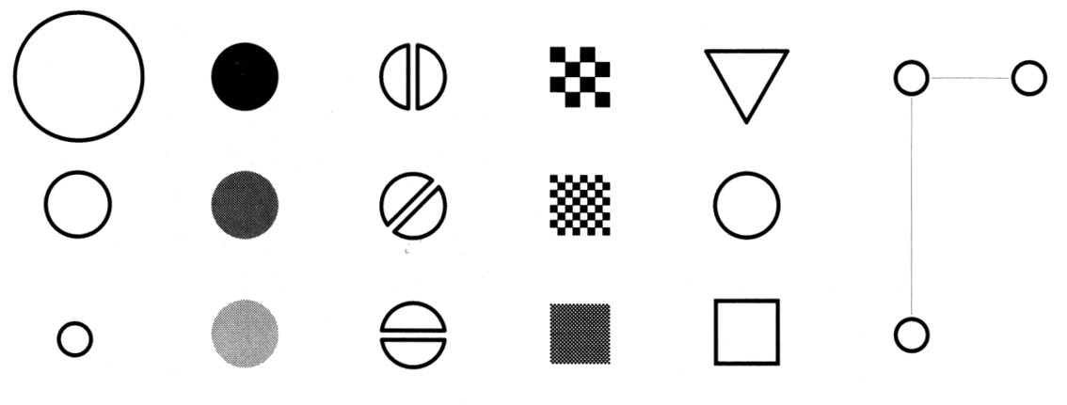
Making Things Distinct
Size
Value
Orientation
Texture
Shape
Position (2D / 3D)
Bertin’s ‘retinal variables’ form the basis for all forms of visual coding. A visual code can be based on (from left to right) contrasts of different types. Hue (chromatic color) provides an addition dimension not shown here.
Kevin Mullet and Darrell Sano, Designing Visual Interfaces
Slide from Marti Hearst/Jeff Heer via Jason Hong
Notes:
Note that while size and other cues provide for quantitative comparison, color (even luminance) only provides for ordering.
If the goal is contrast along any of these axes, make it distinct!

Slide 6
A summary of design elements
Use the eye for pattern recognition: people are good at
Scanning
Recognizing
Remembering images
What they do depends on their “visual query”
Tends to be “just in time”
Key graphical elements
Length
Shape
Orientation
Texture
Animation shows changes across time
Color helps make distinctions
Aesthetics make the process appealing

Slide 7
Small Multiples
http://githut.info/

Slide 8
Rzeszotarski & Kittur: Kinetica: Dynamic Exploration
Notes:
We found that physics-based interactions helped users explore multiple dimensions at once, make more descriptive and comparative findings about their data, and develop a more holistic understanding of a dataset. We invited 16 participants to use the software for 45 minutes in a lab study. As a comparison case, we also invited another group of 16 participants to follow the same study protocol using Excel rather than the application. Interestingly, Kinetica users made far more descriptive, comparative, and relationship findings than their Excel peers who almost always made point or statistical findings (Figure 7; c²(5)=31.3, p<0.001).

Slide 9
Holistic Design Goals
Data & View Specifications | Visualize (choose encoding) Filter (focus on relevant items) Sort (expose patterns) Derive values or models
View Manipulation | Select (to highlight, filter, or manipulate) Navigate (zoom to examine patterns & detail) Coordinate (linked exploration) Organize windows and workspaces.
Process & Provenance | Record analysis histories Annotate patterns to document findings. Share views and annotations Guide users through analysis tasks or stories.
Heer & Shneiderman: Interactive Dynamics for Visual Analysis; ACM QUEUE, Feb 20, 2012
Notes:
Xx http://flowingdata.com/2016/01/19/how-you-will-die/
Tailor to the application and the domain
Create highly interactive and integrated systems
Embed the visualization within a larger application
Provide alternative views

Slide 10
Holistic Design Goals
Data & View Specifications | Visualize (choose encoding) Filter (focus on relevant items) Sort (expose patterns) Derive values or models
View Manipulation | Select (to highlight, filter, or manipulate) Navigate (zoom to examine patterns & detail) Coordinate (linked exploration) Organize windows and workspaces.
Process & Provenance | Record analysis histories Annotate patterns to document findings. Share views and annotations Guide users through analysis tasks or stories.
Heer & Shneiderman: Interactive Dynamics for Visual Analysis; ACM QUEUE, Feb 20, 2012

Slide 11
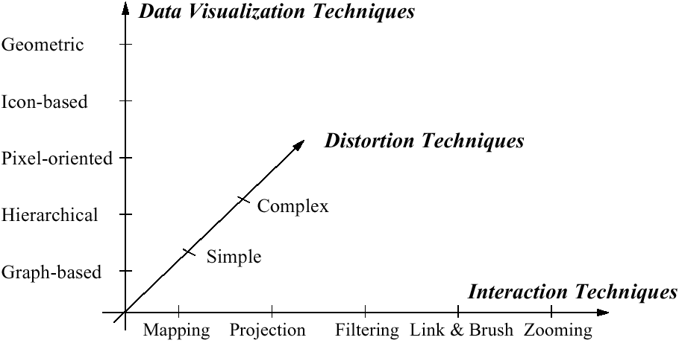
Visualization Techniques
http://www.visual-literacy.org/periodic_table/periodic_table.html
Notes:
nguyen

Slide 12
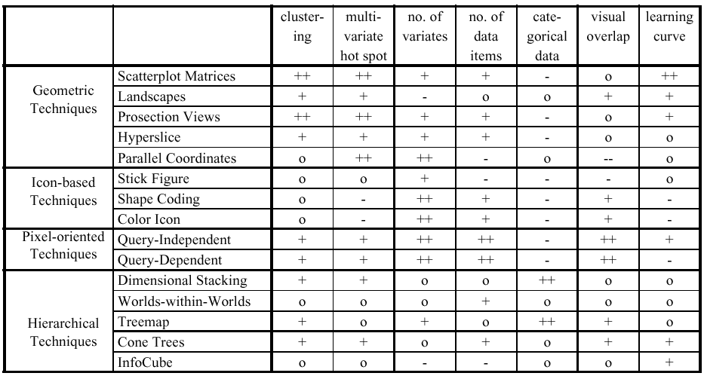
Comparison by Keim

Slide 13
Key Questions to Ask About a Visualization
What is its goal?
Does it use good design?
Have there been usability studies done? What do they show?
Notes:
(and do they match the goal?)
XX UPDATE THIS SLIDE WITH BETTER QUESTIONS

Slide 14
Does visualization help?
The jury is still out
Still supplemental at best for text collections
A correlation with spatial ability
Learning effects: with practice ability on visual display begins to equal that of text

Slide 15
The earth is getting warmer [which is closest to your view]: Create a viz
 | Sci. ‘14 | Sci. ‘09 | Aug 14 | Feb 14 | Oct 13 | Mar 13 | Oct 12 | Nov 11 | Feb 11 | Oct 10 | Sep 09 | April 09 | April 08 | Jan 07 | Aug 06 | Jul 06 | Jun 06
Mostly because of human activity | 87 | 84 | 50 | 40 | 44 | 42 | 42 | 38 | 36 | 34 | 36 | 49 | 47 | 47 | 47 | 50 | 41
Mostly because of natural patterns in the earth’s environment | 9 | 10 | 23 | 18 | 18 | 23 | 19 | 18 | 18 | 18 | 16 | 36 | 18 | 20 | 20 | 23 | 21
No solid evidence it is warming | 3 | 4 | 25 | 35 | 26 | 27 | 26 | 28 | 34 | 32 | 33 | 11 | 21 | 16 | 17 | 17 | 20
Don’t know/refused | 1 | 2 | 2 | 6 | 9 | 8 | 12 | 14 | 10 | 14 | 14 | 4 | 11 | 16 | 15 | 9 | 17

Slide 16
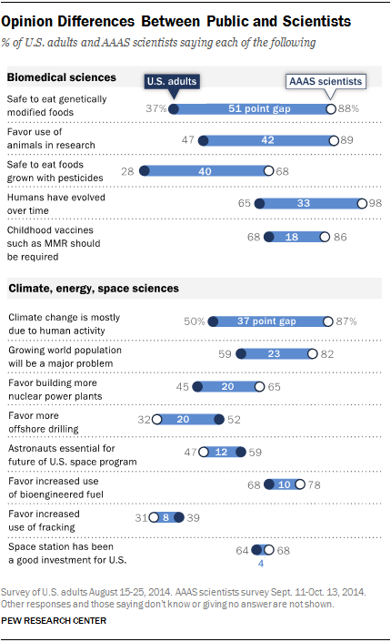
Notes:
Lightweight Visualization – what’s left out is as important as what is put in

Slide 17
Notes:
What’s even more important is what the ensured was included at the top and bottom…

Slide 18
Summary Visualization Guidelines
Set a Goal: Explore/calculate/communicate
Define visual queries/comparisons to support/stories to tell
Document process & provenance for credibility
Create highly interactive and visually integrated systems (images/words/…)
Embed the visualization within a larger application
Provide alternative views

